Slide 1

Advanced
Diffusion Weighted Imaging
MP/ NTP 651

Slide 2
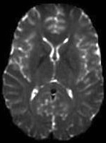
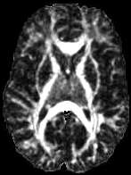
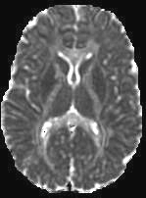
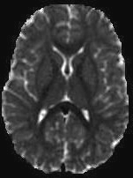
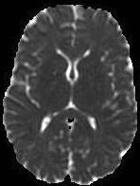
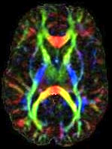
Diffusion Tensor Imaging
Basser et al. (1994)
Non-invasive imaging technique for estimating the diffusion properties of water in biological tissues
Highly sensitive to differences in tissue microstructure
Diffusion in white matter is anisotropic (varies with direction)
Fractional
Anisotropy
(‘White
Matter’)
T2W
Structure
Mean
Diffusivity
(1/Density)
Orientation
of White
Matter
Axial Diffusivity
(‘Axons’)
Radial Diffusivity
(‘Myelin’)

Slide 3
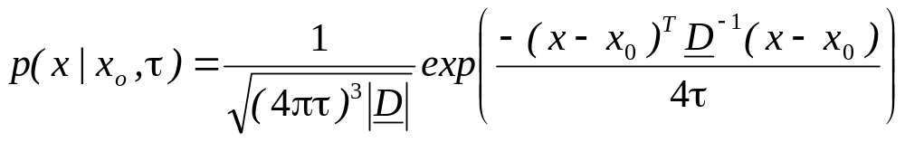
The Diffusion Tensor Model
z
z
ε₁, λ₁
ε₂, λ₂
y
y
ε₃, λ₃
x
x
Diffusion Propogator:
Zero-Mean 3D Multivariate Normal

Slide 4
Limitations of DTI
Good Model
  Lower b (< 1500 s/mm²)
  Homogenous Tissues
Diffusion Not Always Gaussian
  Multiple Gaussian compartments
  Crossing WM Fibers
  Restricted diffusion – compartmental boundaries (membranes)

Slide 5
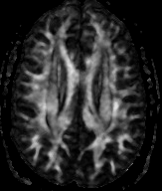
Partial Volume Effects on Anisotropy
SLF
CR
CC
CING
DT-MRI Alexander

Slide 6
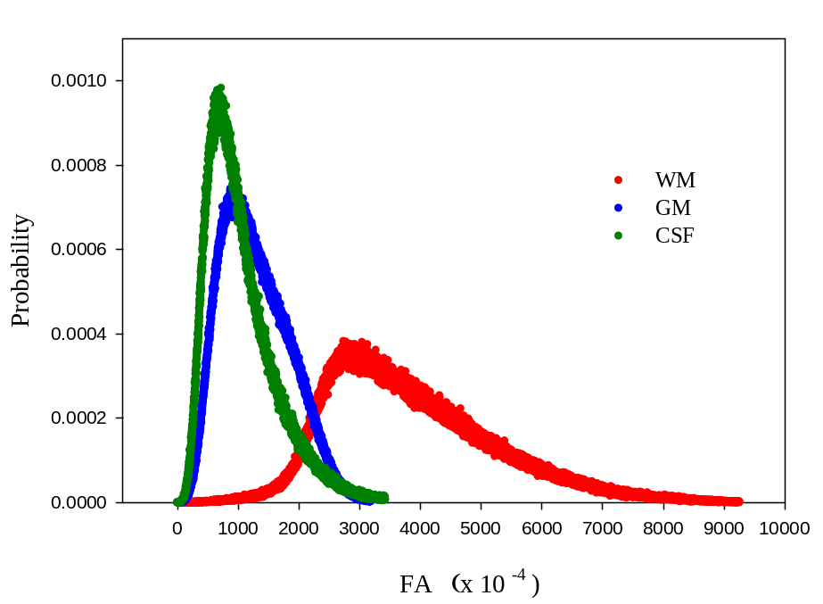
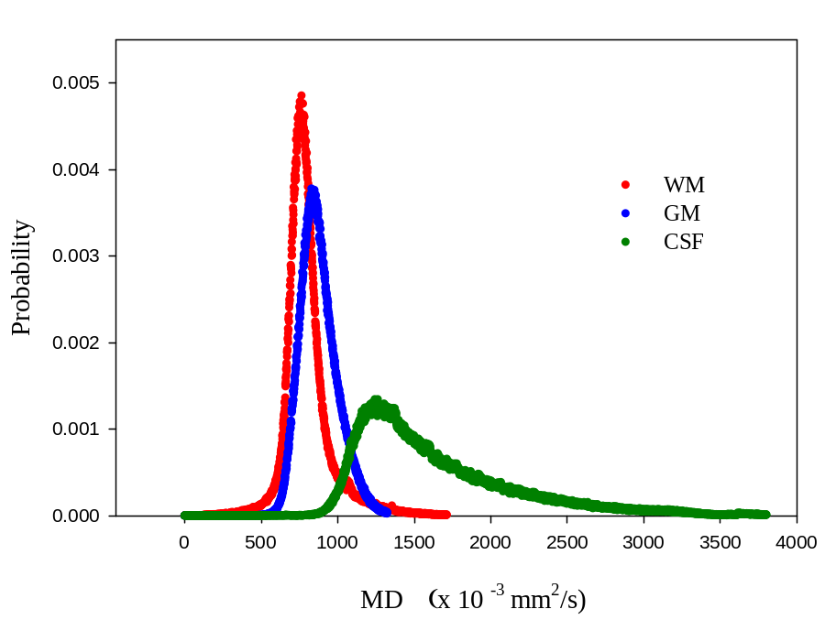
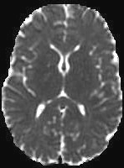
DTI Histograms

Slide 7
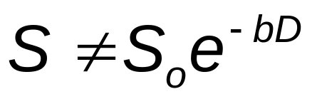
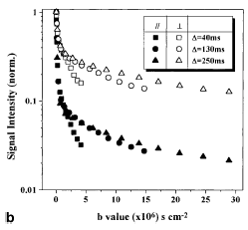
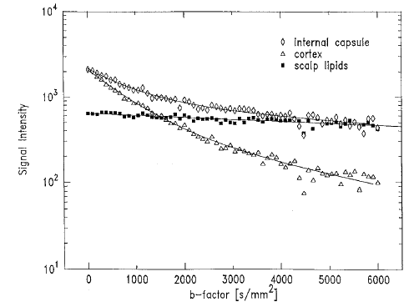
Non-Monoexponential Diffusion
For b > 1500 s/mm2
Mulkern et al. NMR Biomed 1999
Assaf et al. MRM 2000

Slide 8
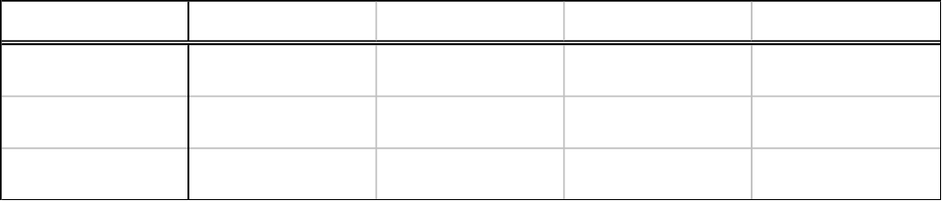
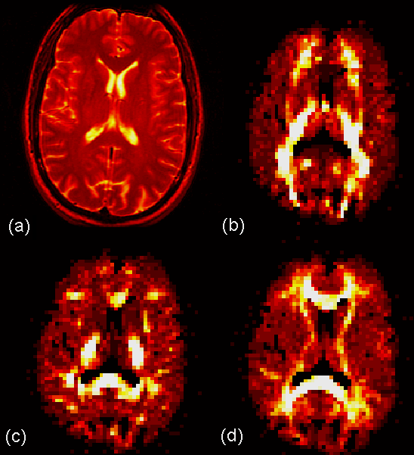
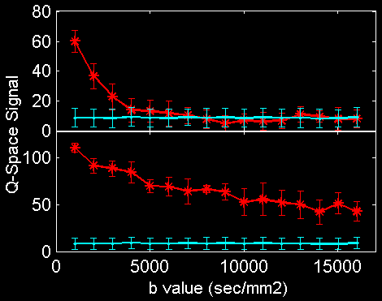
High Diffusion Weighting
Exponential DW Signal: S = S_{o}exp(-bD)
T2WI
x
GM: Insula
b_{max}
15000
10000
WM: CC Splenium
5000
~40% !!
s/mm²
y
z
DT-MRI Alexander
Courtesy YC Wu

Slide 9
Complex Diffusion Characterization
High Angular Resolution Diffusion Imaging (HARDI)
Diffusion Kurtosis Imaging
Model-based – NODDI
Diffusion Spectrum Imaging (DSI)

